Slide 1
Strategic and Operational Priorities – Developing Awareness and Setting SMART goals. Where are you now? Where do you need to be, as a leader in your service? How will you get there?

Slide 2
Strategic Vs Operational
Strategic Planning
Operational Planning
Applies to the entire organisation
Establish the organisations overall goals /objectives
Positions organisation in terms of its environment
Covers and extended period of time
Assumes objectives exist
Specifies details of how overall goals will be achieved
Covers shorter time period
Strategic Management
Organisation-wide, holistic
Conceptualisation of issues
Creating new directions: new resource allocations
Developing new resources
Ambiguous/Uncertain
Long term perspective
Operational Management
Functional , Organised
Techniques , processes, actions
Managing existing resources
Optimising existing resources
Functionally and Operationally specific
Day to day issues, annual operating plan

Slide 3
Strategic Vs Operational
Strategic Goals
Operational Goals
Doing things differently. Doing the right things.
Long–term (2-5years)
Aligned with mission/vision
Gives to operational goals/objectives
Sustainable advantages. Long-terms benefits and profitability.
Game of senior management/boards
Doing things better. Doing things right.
Short-term (week , month, quarterly)
Aligned with strategic goals/objectives
Allows achieving strategic goals by giving workable execution plan
Best practice. Short-term benefits and profitability.
Game of middle management/line managers

Slide 4
A 5-minute reflective exercise: Where am I, today?
Why does your service exist?
What value does your service provide to those who need to access it?
What values guide how you expect people to behave in your service?
What are the long-term goals of your service?
Where are we now?
Where do we need to be?
How will we get there?
What yearly goals do you need to set to make progress toward the long-term goals.
Where are we now?
Where do we need to be?
How will we get there?
How do you measure and report on progress?

Slide 5
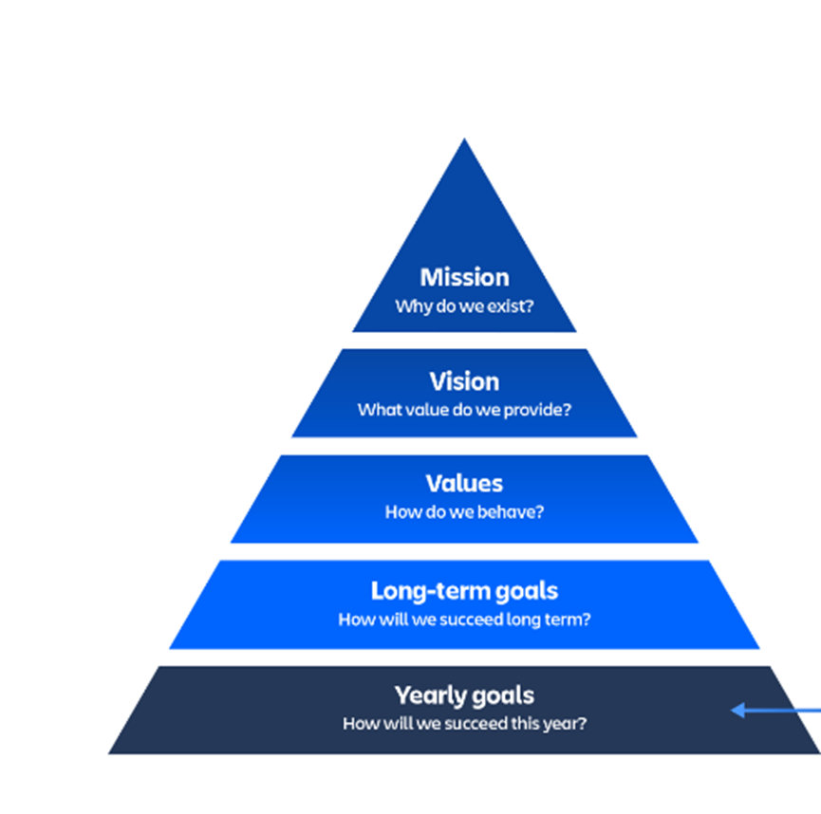
A 2-minute reflective exercise: Where do I need to get to, as a leader in my service?
Don’t worry if you didn’t know some of the answers.
Consider where you need to get to – and how you could get there
what you could read,
where you could look,
what meetings could you ask to attend,
who you could ask,
who could you shadow.

Slide 6
A 2-minute reflective exercise: How will I get there? Write one SMART goal (just one, to begin with)
What will you do
How will you know you have done it ?
Make it life-sized – manageable within the actual circumstances of your current situation.
What makes this worth your while?
When will you do this by?

Slide 7
12 mins - sharing and learning together – in action learning sets
2 mins each – someone hold the time for your group.
Something I noticed from this exercise.
My one SMART goal
you could ask the group to help you stay accountable to this goal by asking them to check in on progress next time we meet.
Something I now wonder…or realise.

Slide 8
5 mins - sharing and learning together in plenary
2 mins each – someone hold the time for your group.
Something I noticed from this exercise.
My one SMART goal
you could ask the group to help you stay accountable to this goal by asking them to check in on progress next time we meet.
Something I now wonder…or realise.

Slide 9
Face the four fatal fears at work – can you tame them rather than having them stall (or kill) your progress (Maxie Maultsby)
Fear of failure
What if I can’t do this?
What if I can do it?
Fear of being wrong
What if I make a mistake?
What if I get it right?
Everyone makes mistakes. Making them feels uncomfortable. What is this feeling and what do I need to do to take care of it. And what can I learn so things work out better next time.
Fear of rejection
What if they say no.
What if they say yes.
No-one has all their ideas accepted first time round. It feels unconformable when the answer is no. What is this feeling and what do I need to do to take care of it. And what can I learn so things might work out better next time.
Fear of uncomfortable emotions
What if I feel embarrassed, or anxious, or frustrated, or disappointed, or…
Everyone feels uncomfortable emotions sometimes. What is this feeling and what do I need to do to take care of it. And what can I learn about managing my uncomfortable emotions, so things work our better for me next time.

