Slide 1
Collective Force for Health and Wellbeing
Digital health inclusion webinar
12 December 2024

Slide 2
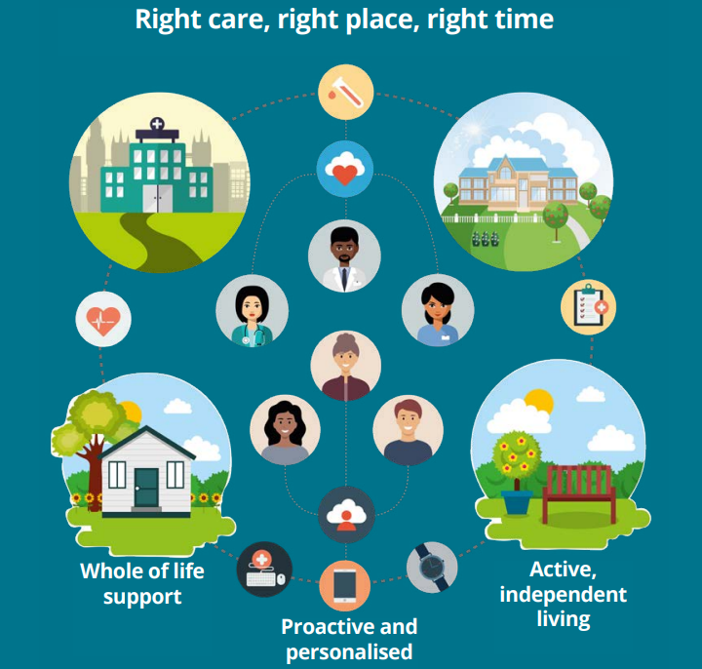
Digital Health and Care Strategy vision
Notes:
Vision is centred around using technology to shift balance of care into community, support prevention and self-management. Dependent on community-based services to make it real.

Slide 3
Digital health inclusion
“having easy and affordable access to a suitable device with sufficient data and internet connectivity, and the digital skills and health literacy to find and understand information about a health condition and treatment options” (NHS England, 2023).

Slide 4
The challenge
8.5m people lack the most basic digital skills.
1 in 20 UK households have no home internet access.
2m UK households struggle to afford internet access.
5.8m people will still be digitally excluded in 2032 without action.
Key determinants:
Socioeconomic factors
Education
Remoteness and rurality
Age
Disability
Religion/belief
Gender – 61% of people having zero digital skills are women.
Good Things Foundation, 2024

Slide 5
Libraries as a Collective Force for digital inclusion
Place-based partners
Signposting to local ecosystem
The offer: access, skills, devices
Flexible, adaptable approach to skills – employment, finance, hobbies, health
Digital inclusion in library & local strategy
Link digital inclusion to local priorities such as improving health and wellbeing, and access to resources and support for employment
Working with community and third sector groups to meet specific needs
Open door – universal access to wifi and devices
Lending of devices
Good Things Foundation 2023: Digital inclusion in libraries
Notes:
3 key ways in which libraries enable digital inclusion.

Slide 6
Collective Force Digital Inclusion Webinar – 12.12.25
Digital Citizens Unit Scottish Government
Digital Inclusion Alliance

Slide 7
What is the digital divide?
The digital divide is the gap between people in society who have full access to digital technology and those who do not. The reasons why someone may be digitally excluded include:
Not being able to access infrastructure that provides access to the internet or being unable to afford a connection package
Not having access to a device such as a smartphone, laptop or tablet which connects to the internet
Not having the skills to use a device and/or navigate the online environment
Choosing not to use the internet and/or learn the necessary skills required

Slide 8
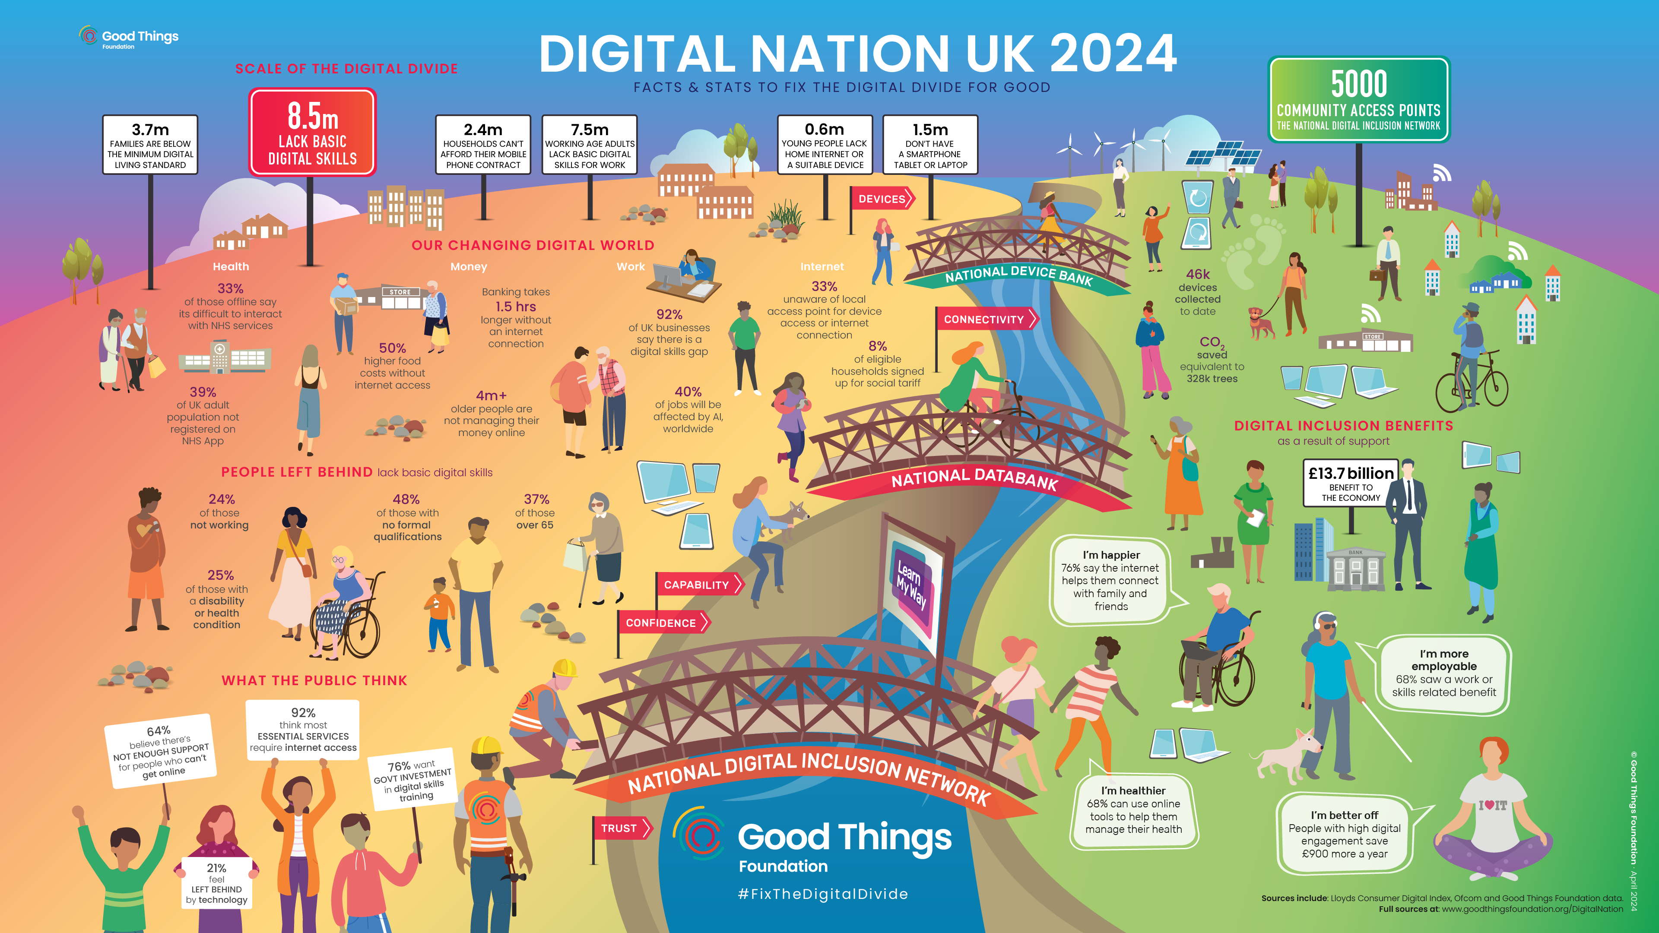

Slide 9
What is the Digital Inclusion Challenge?
How do we develop the big picture understanding that digital inclusion is a creator, indicator and predictor of poverty?
• How do we eliminate the geographical inequity that derives from the lack of consistent awareness of the impact and importance of digital exclusion?
• How do we develop sustainable models that help us focus on prevention of digital exclusion and that reduces demand/exclusion further downstream?
• How do we tackle challenges once rather than developing multiple solutions, multiple times?
• How do we work together to tackle the major structural barriers in how we design and deliver services and solutions?
• How do we coordinate investment more effectively to create the greatest impact from the resources we have and avoid duplication?
• How do we build capacity and capability on the ground to provide sustainable support from the most appropriate professional?
• How do we build people’s confidence, motivation and skills to participate in digital society throughout their life course?

Slide 10
Digital Inclusion Alliance
Proposed national delivery mechanism to bring together the public, private and third sector to support an innovation community to;
Work across the system and sectors to support change and provide leadership
Commit to invest expertise, resource, data and funding to support outcomes
Identifying the challenges that are slowing down progress and working together to eliminate them
• Coordinating changes that need to happen
• Monitoring progress towards agreed outcomes and goals

Slide 11
Digital inclusion in health and social care
Digital Inclusion Programme
Dr Tara French
Scottish Government
December 2024
Image credit: Tessa Mackenzie

Slide 12
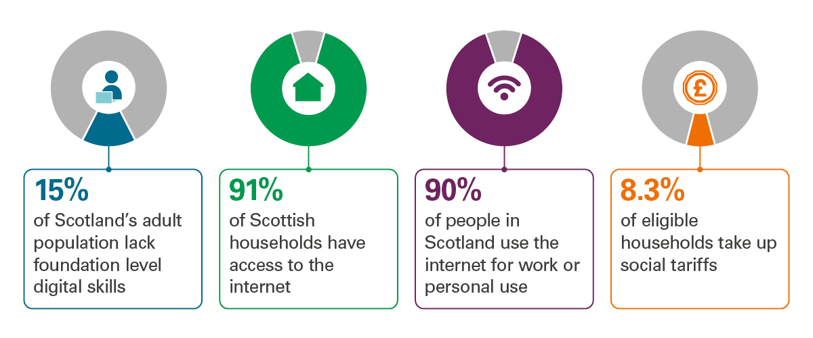
Tackling digital exclusion – Audit Scotland
Clear leadership and focus needed to tackle digital exclusion

Slide 13
Digital inclusion – a social determinant of health
Digital inclusion is our collective responsibility to ensure that everyone can benefit from being online.
(Slater and French, 2023)

Slide 14
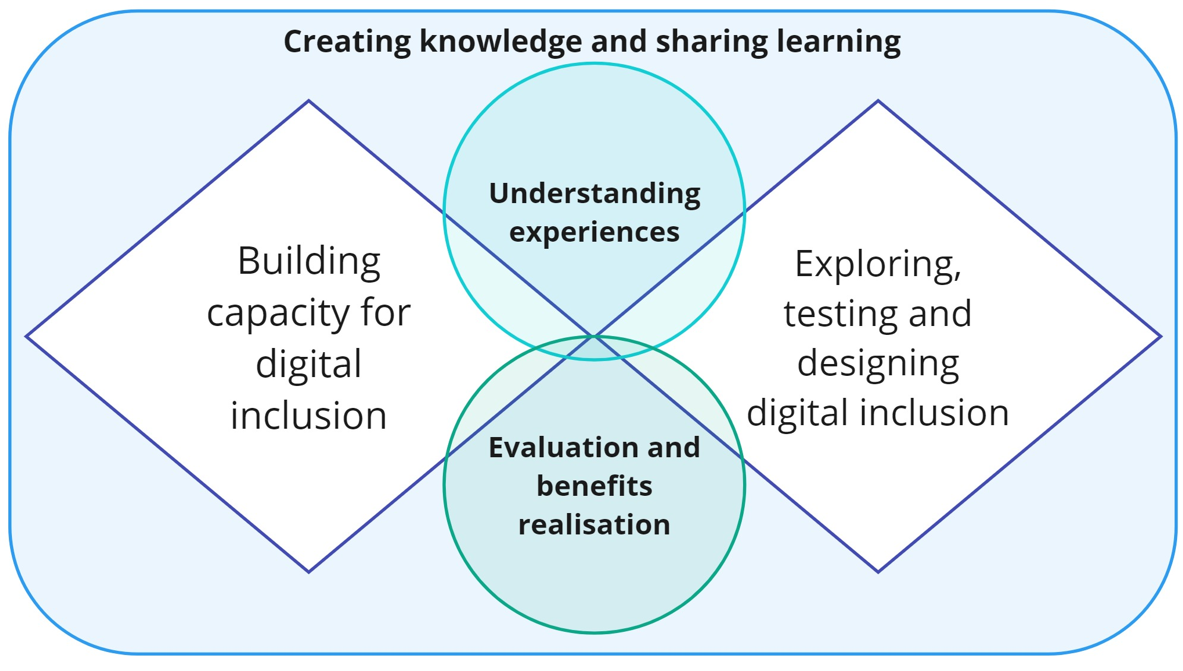
Programme thematic areas

Slide 15
Pillars for Digital Inclusion
Creating knowledge and sharing learning

Slide 16
Programme thematic areas

Slide 17
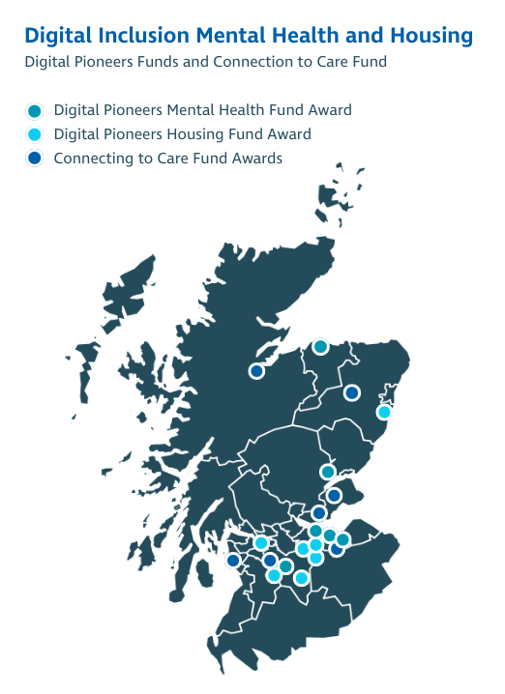
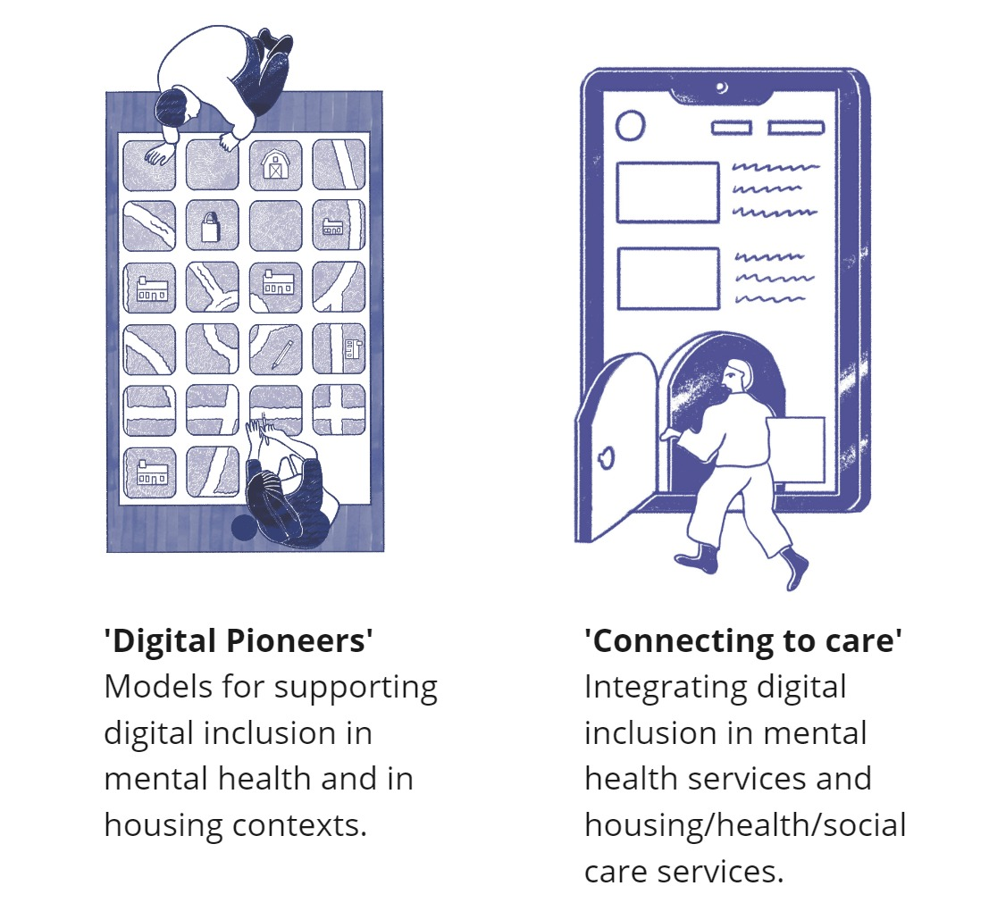
Digital inclusion funded projects
Exploring, testing and designing

Slide 18
Programme thematic areas

Slide 19
Practicing digital inclusion
To equip care/service providers with the tools and resources required to effectively embed digital inclusion in core service delivery.
A digital inclusion practice guide for frontline staff
Digital Champions training for health and care
Contributing materials to the NES digital health and care learner pathways
Image credit: Tessa Mackenzie
Building capability

Slide 20
Programme thematic areas

Slide 21
Purposeful engagement
Image credits: Holly Davey
Understanding experiences

Slide 22
Programme thematic areas

Slide 23
Creating an evidence base
Benefits realisation strategy and plan
Programme evaluation – cost/benefit
Understanding needs of health and social care ‘systems’
Strategy/policy
Service
Workforce
Creating a ‘package’ and policy framework to support digital inclusion in practice across health and social care
Models of digital inclusion
Image credit: Tessa Mackenzie
Evaluation and benefits realisation

Slide 24
Thank you
https://tec.scot/programme-areas/digital-inclusion
Image credit: Tessa Mackenzie (DHI Imagination Series)

