Slide 1
Stroke Thrombolysis Pathway: 0 – 4.5 hours
PATIENT NAME: _______________________________
CHI/DOB:
_______________________________
Assessing clinician:
Grade:
Date:
___/___/_____
Time of assessment:
_____:_____
Time of symptom onset: _____:_____
Time of arrival in ED _____:_____
Or tick if exact time of onset not known:
Presenting symptom(s):
Significant PMH:
Medications (esp. anticoagulants):
Total NIHSS score (see scoring tool on page 5):
Blood pressure:
If >185/110mmHg, see page 6
Contraindications? (see overleaf):
No
Yes
CT Head outcome*
Df
(stroke consultant
Interpreation do not wait
*do not wait for formal report, stroke team should interpret real time where possible
DECISION TO THROMBOLYSE (after discussion with ARI stroke team if OOH):
Explain decision:
If for thrombolysis, continue to page 2. If not inform ED team.
.
Pg 1

Slide 2
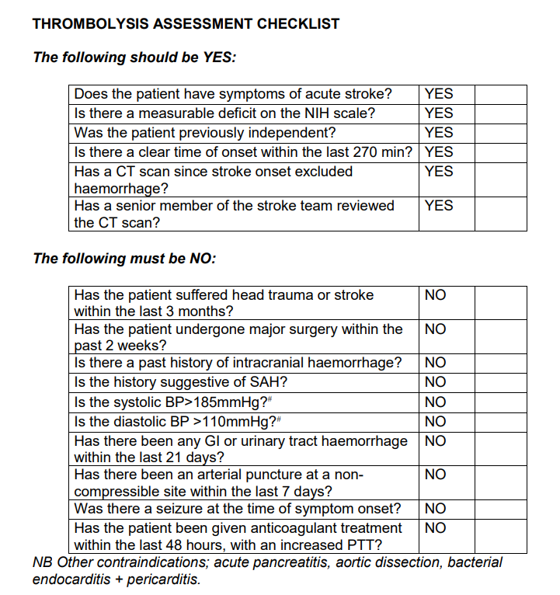
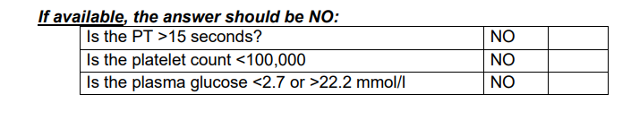
Pg 2

Slide 3
Stroke Thrombolysis Pathway: 0 – 4.5 hours
PATIENT NAME: _______________________________
CHI/DOB:
_______________________________
Verbal consent from patient/NOK:
Yes
No
If for thrombolysis, give IV alteplase (see page 4 for dosing):
IV Alteplase Prescription: Signed Prepared by Given by Time started
Alteplase bolus dose mg
Alteplase infusion mg over 1 hour
Prime line (usually 2ml) First syringe (volume ml)
Second syringe, if req (volume ml)
Bolus should be administered by hand over 2 minutes. Infusion rate in ml/hr is the same as the dose in mg/hr
/
(✓)
/
/
This is a focused assessment towards a decision for stroke thrombolysis and DOES NOT replace a full ED assessment or medical clerking.
If thrombolysis administered, arrange admission to Medical High Dependency Unit (bleep 4000).
See page 7 for guidance for the deteriorating patient post thrombolysis
Pg 3

Slide 4
Body Weight/ Dose Chart for Alteplase 1mg/ml
Body Weight (Kg) | Approx. Body Weight (Imperial) | Total Alteplase dose (mg) | IV Bolus 10% of total dose (ml) | IV Infusion 90% of total dose (ml/hr) | No. of 50mg Alteplase vials required | Dose Selected (Tick)
40 | 6st 4 | 36 | 4 | 32 | 1
42 | 6st8 | 38 | 4 | 34 | 1
44 | 6st13 | 40 | 4 | 36 | 1
46 | 7st3 | 41 | 4 | 37 | 1
48 | 7st7 | 43 | 4 | 39 | 1
50 | 7st12 | 45 | 5 | 40 | 1
52 | 8st2 | 47 | 5 | 42 | 1
54 | 8st7 | 49 | 5 | 44 | 1
56 | 8st11 | 50 | 5 | 45 | 2
58 | 9st1 | 52 | 5 | 47 | 2
60 | 9st6 | 54 | 5 | 49 | 2
62 | 9st10 | 56 | 6 | 50 | 2
64 | 10st1 | 58 | 6 | 52 | 2
66 | 10st5 | 59 | 6 | 53 | 2
68 | 10st9 | 61 | 6 | 55 | 2
70 | 11st | 63 | 6 | 57 | 2
72 | 11st4 | 65 | 6 | 59 | 2
74 | 11st9 | 67 | 7 | 60 | 2
76 | 11st13 | 68 | 7 | 61 | 2
78 | 12st3 | 70 | 7 | 63 | 2
80 | 12st8 | 72 | 7 | 65 | 2
82 | 12st12 | 74 | 7 | 67 | 2
84 | 13st3 | 76 | 8 | 68 | 2
86 | 13st7 | 77 | 8 | 69 | 2
88 | 13st12 | 79 | 8 | 71 | 2
90 | 14st2 | 81 | 8 | 73 | 2
92 | 14st6 | 83 | 8 | 75 | 2
94 | 14st11 | 85 | 8 | 77 | 2
96 | 15st1 | 86 | 9 | 77 | 2
98 | 15st6 | 88 | 9 | 80 | 2
100 | 15st10 | 90 | 9 | 81 | 2
> 100 kg, use 90 mg maximum
PATIENTS MUST BE CONTINUOSLY MONITORED PRIOR TO AND DURING DRUG ADMINISTRATION and closely monitored for at least 24 hrs following administration.
1. Total dose: 0.9mg/kg, based on actual or estimated body weight. Maximum dose is 90mg.
2. Must be prescribed on front sheet of protocol, following discussion with responsible
Consultant
3. Reconstitute each 50mg alteplase vial with 50ml of Water For Injection via the transfer spike
to give a solution with concentration 1mg/ml.
4. Initial 10% of total dose given as an IV manual push over 2mins administered with an
experienced doctor present.
5. Prime infusion line (usually 2ml). This volume is in addition to the prescribed volume, as the
volume left in the line after the infusion does not enter the patient.
6 Administer remaining 90% of total dose, commencing immediately after initial bolus, and
delivered over 60 minutes. (Infusion rate in ml/hr is the same as the dose in mg/hour)
7 If infusion volume (dose) is >60ml, a second syringe is required.
Pg 4

Slide 5
National Institutes of Health Stroke Scale (NIHSS)
1a Level of
Consciousness
(LOC)
1b LOC
Questions
1c LOC
Commands
2. Best Gaze
3.Visual Fields
4. Facial Palsy
5. Best Motor
RIGHT ARM
6. Best Motor
LEFT ARM
7. Best Motor
RIGHT LEG
8. Best Motor
LEFT LEG
9. Limb Ataxia
10. Sensory
11. Best
Language
12. Dysarthria
13. Neglect
0
1
2
3
0
1
2
0
1
2
0
1
2
0
1
2
3
0
1
2
3
0
1
2
3
4
0
1
2
3
4
0
1
2
3
4
0
1
2
3
4
0
1
2
0
1
2
0
1
2
3
0
1
2
0
1
2
0
1
2
3
0
1
2
0
1
2
0
1
2
0
1
2
3
0
1
2
3
0
1
2
3
4
0
1
2
3
4
0
1
2
3
4
0
1
2
3
4
0
1
2
0
1
2
0
1
2
3
0
1
2
0
1
2
Alert- keenly responsive
Drowsy- rousable by minor stimulation to obey, answer, or respond
Stuporous- requires repeated stimulation to attend, or is obtunded and requires strong or painful stimulation to make movements (not stereotyped)
Comatose- responds only with reflex motor or autonomic effects or totally unresponsive, flaccid
Answers both correctly
Answers one correctly
Both incorrect Patient is asked to state the month & his / her age
Obeys both correctly
Obeys one correctly
Both incorrect Patient is asked to open & close eyes, grip & release normal hand
Normal
Partial gaze palsy- gaze is abnormal in one or both eyes, no forced deviation/total gaze paresis
Forced deviation- or total gaze paresis not overcome by oculocephalic maneouvre
No visual loss(or in a coma)
partial hemianopia
complete hemianopia
bilateral hemianopia-including cortical blindness
Normal
Minor- flattened nasolabial fold, asymmetry on smiling
Partial- total or near total paralysis of lower face
Complete- absent facial movement in upper and lower face and lower face on one or both sides
No drift- holds limb at 90 degrees for full 10 seconds
Drift- drifts down but does not hit bed
Some effort against gravity
No effort against gravity
No movement
No drift- holds limb at 90 degrees for full 10 seconds
Drift- drifts down but does not hit bed
Some effort against gravity
No effort against gravity
No movement
No drift- holds limb at 45 degrees for full 5 seconds
Drift- drifts down but does not hit bed
Some effort against gravity
No effort against gravity
No movement
No drift- holds limb at 45 degrees for full 5 seconds
Drift- drifts down but does not hit bed
Some effort against gravity
No effort against gravity
No movement
Absent(or in coma)
Present in 1 limb
Present in 2 or more limbs
Normal
Partial loss- patient feels pinprick is less sharp or is dull on affected side
Dense loss(or in coma)- patient is unaware of being touched on face, arm, leg
No dysphasia
Mild- moderate dysphasia obvious loss of fluency or comprehension, without significant limitation on ideas expressed or form of expression. Makes conversation about provided material difficult or impossible, e.g. examiner can identify picture or naming card from patient’s response.
Severe dysphasia- all communication is through fragmentary expression; great need for inference, questioning, and guessing by the listener who carries burden of communication. Examiner cannot identify materials provided from patient response
Mute- no usable speech or auditory comprehension, or in coma.
Normal articulation
Mild- moderate dysarthria- patient slurs some words can be understood with some difficulty.
Unintelligible or worse- speech is so slurred as to be unintelligible (absence of or out of proportion to dysphasia) or is mute / anarthric, or in coma
No neglect(or in a coma)
Partial neglect- visual, tactile, auditory, spatial, or personal inattention or extinction to bilateral simultaneous stimulation in one of the sensory modalities
Complete neglect- profound hemi-inattention or hemi-inattention to more than one modality. Does not recognise own hand or orients to only one side of space
Total Score:
Repeat at 24hrs
Pg 5

Slide 6
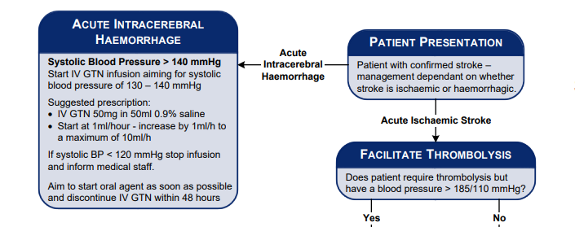
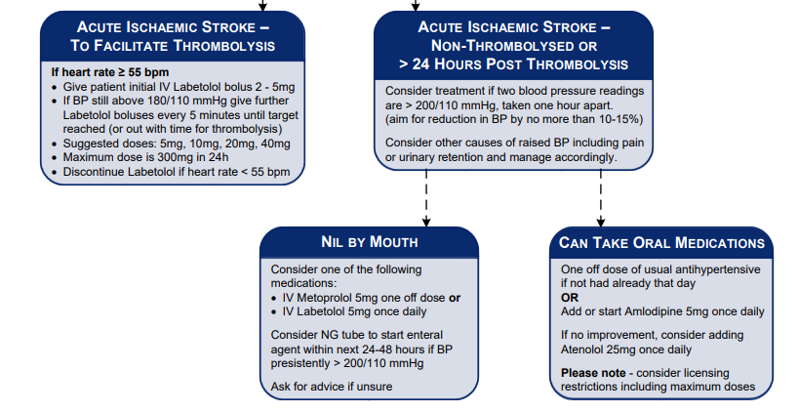
Notes (Medical/Nursing)
Date & Time
Stroke Blood Pressure control
…………………………………………………………………………………………………..…………………………………………………………….
……………………………………………………………………………………………………..………………………………………………………….
………………………………………………………………………………………………………..……………………………………………………….
…………………………………………………………………………………………………………..…………………………………………………….
……………………………………………………………………………………………………………..………………………………………………….
………………………………………………………………………………………………………………..……………………………………………….
…………………………………………………………………………………………………………………..…………………………………………….
……………………………………………………………………………………………………………………..………………………………………….
………………………………………………………………………………………………………………………..……………………………………….
…………………………………………………………………………………………………………………………..…………………………………….
……………………………………………………………………………………………………………………………..………………………………….
………………………………………………………………………………………………………………………………..……………………………….
…………………………………………………………………………………………………………………………………..…………………………….
……………………………………………………………………………………………………………………………………..………………………….
………………………………………………………………………………………………………………………………………..……………………….
…………………………………………………………………………………………………………………………………………..…………………….
……………………………………………………………………………………………………………………………………………..………………….
………………………………………………………………………………………………………………………………………………..……………….
…………………………………………………………………………………………………………………………………………………..…………….
……………………………………………………………………………………………………………………………………………………..………….
………………………………………………………………………………………………………………………………………………………..……….
…………………………………………………………………………………………………………………………………………………………..…….
……………………………………………………………………………………………………………………………………………………………..….
………………………………………………………………………………………………………………………………………………………………...
..……………………………………………………………………………………………………………………………………………………………….
…..…………………………………………………………………………………………………………………………………………………………….
……..………………………………………………………………………………………………………………………………………………………….
………..……………………………………………………………………………………………………………………………………………………….
…………..…………………………………………………………………………………………………………………………………………………….
……………..………………………………………………………………………………………………………………………………………………….
……………………..………………………………………………………………………………………………………………………………………….
………………………..……………………………………………………………………………………………………………………………………….
…………………………..…………………………………………………………………………………………………………………………………….
……………………………..………………………………………………………………………………………………………………………………….
………………………………..……………………………………………………………………………………………………………………………….
…………………………………..…………………………………………………………………………………………………………………………….
……………………………………..………………………………………………………………………………………………………………………….
………………………………………..……………………………………………………………………………………………………………………….
………………………………………..…….………………………………………………………………………………………..….…………………….
……………………………………………..………………………………………………………………………………………………………………….
…………………………………………..…………………………………………………………………………………………………………………….
……………………………………………..………………………………………………………………………………………………………………….
………………………………………………..……………………………………………………………………………………………………………….
…………………………………………………..…………………………………………………………………………………………………………….
Please note that in the event of an intracerebral haemorrhage all anticoagulants must be reversed, including warfarin and DOAC group, with guidance from the haematologist on call. Ensure that a platelet count and coagulation screen have been performed.

Slide 7
NEUROLOGICAL DETERIORATION SINCE THROMBOLYSIS
IF THERE IS A FALL IN CONSCIOUS LEVEL SINCE THROMBOLYSIS BY 1 SQUARE OR MORE IN GCS CHART OR IF SPEECH + ARM + LEG TOTAL FALLS BY 2 SQUARES OR MORE SINCE THROMBOLYSIS THEN: STOP ALTEPLASE INFUSION IF IT IS STILL RUNNING CHECK BP AND BM INFORM DOCTOR DOCTOR CONSIDER URGENT CT HEAD CONTACT STROKE PHYSICIAN ON CALL IF UNSURE NIL BY MOUTH UNLESS ABLE TO REASSESS SWALLOW CHECK CLOTTING IF HAEMORRHAGE OR MASSIVE OEDEMA ON CT SCAN THEN CONTACT NEUROSURGEONS IF HAEMORRHAGE AND CLOTTING ABNORMAL THEN GIVE CRYOPRECIPITATE
HYPERTENSION |  |  | HYPOTENSION
IF SYSTOLIC BP ABOVE 180mm Hg OR IF DIASTOLIC ABOVE 105mm Hg AT ANY TIME THEN: CONFIRM WITH MANUAL MEASUREMENT CHECK FOR PAIN AND TREAT CAUSE IF STILL ABOVE RANGE RECHECK IN 5 MINUTES INFORM DOCTOR CONSIDER IV labetalol or GTN |  |  | IF SYSTOLIC BP BELOW 95mmHg THEN: STOP BP TREATMENTS CHECK FOR EXTERNAL OR INTERNAL BLEEDING (SEE BELOW) RECHECK IN 5 MINUTES IF STILL BELOW RANGE INFORM DOCTOR, GIVE IV FLUIDS IF APPROPRIATE, URGENT BLOODS FOR FBC / CLOTTING
HYPOXIA
IF OXYGEN SATURATION BELOW 94% THEN: SIT PATIENT UP CONSIDER OXYGEN THERAPY - IF REQUIRED, TITRATE OXYGEN DELIVERY TO SATS OF 94-98%, OR 88-92% IN SEVERE COPD INFORM DOCTOR
BLEEDING
IF MAJOR BLEEDING STOP ALTEPLASE INFUSION INFORM DOCTOR GIVE IV FLUIDS URGENT BLOODS FOR FBC / CLOTTING
Date | Time | Comment and Action Taken |  | Signed

