Slide 1
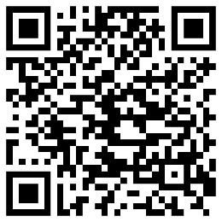
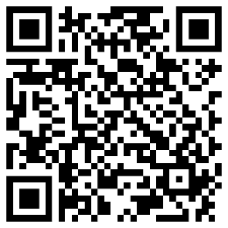
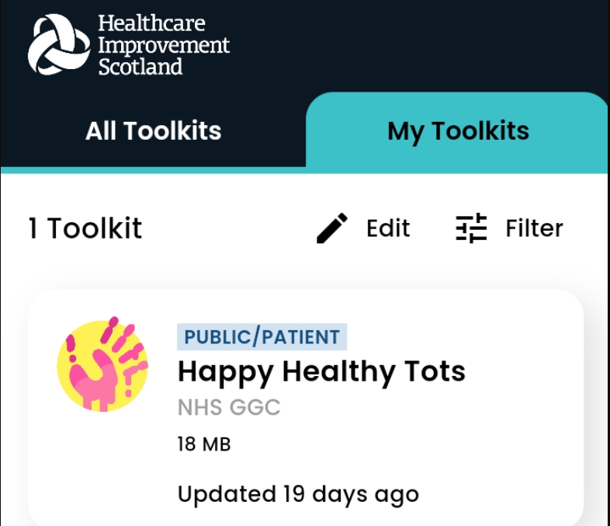
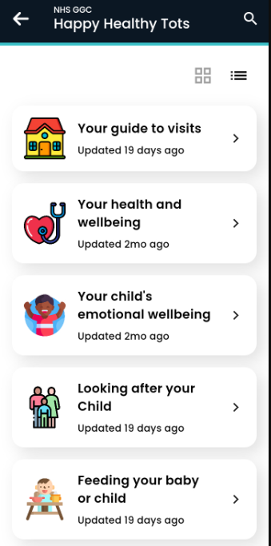
Happy Healthy Tots - Download RDS App
Android
Apple
Use QR code to install Right Decisions for Health and Care app.​
Once downloaded search for​ “Happy Healthy Tots” and add to your toolkit.​
It will be available afterwards in the “My toolkits” tab.​

